Slide 1
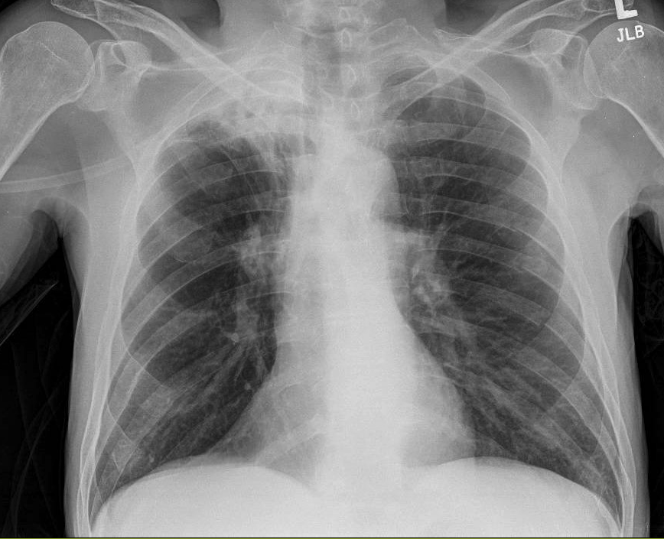
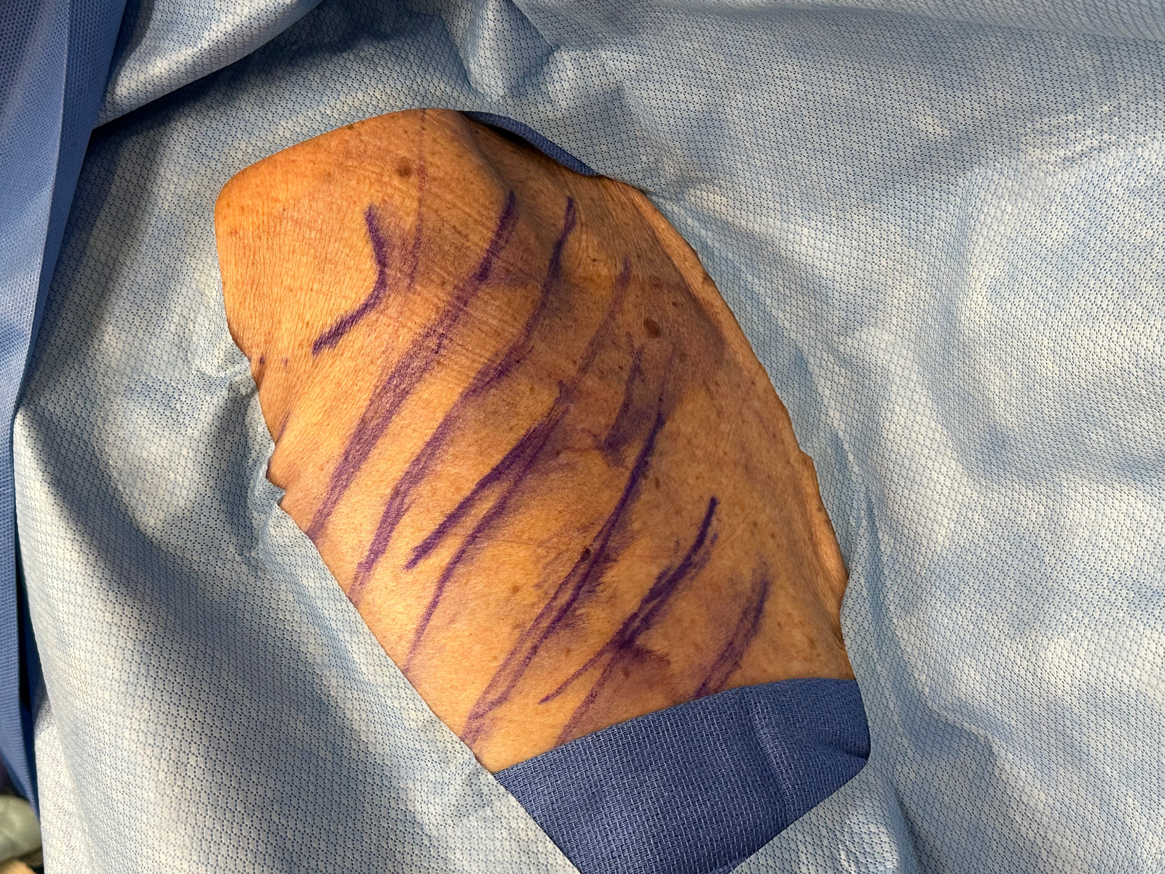
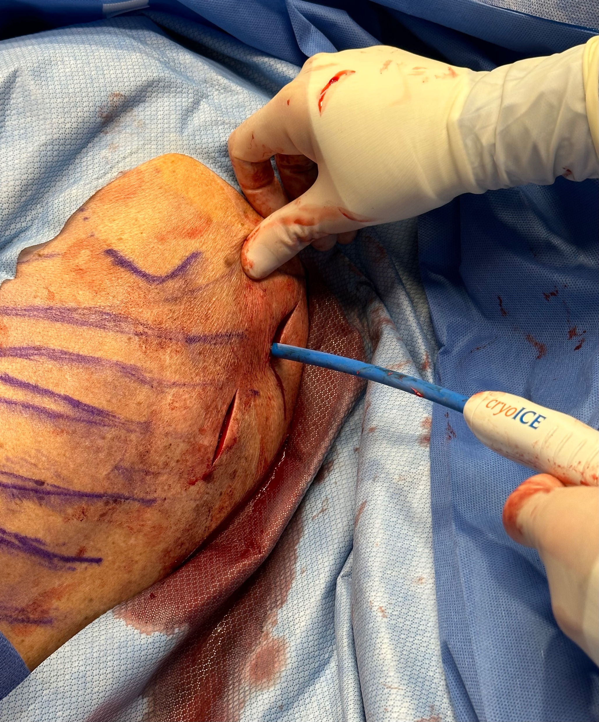
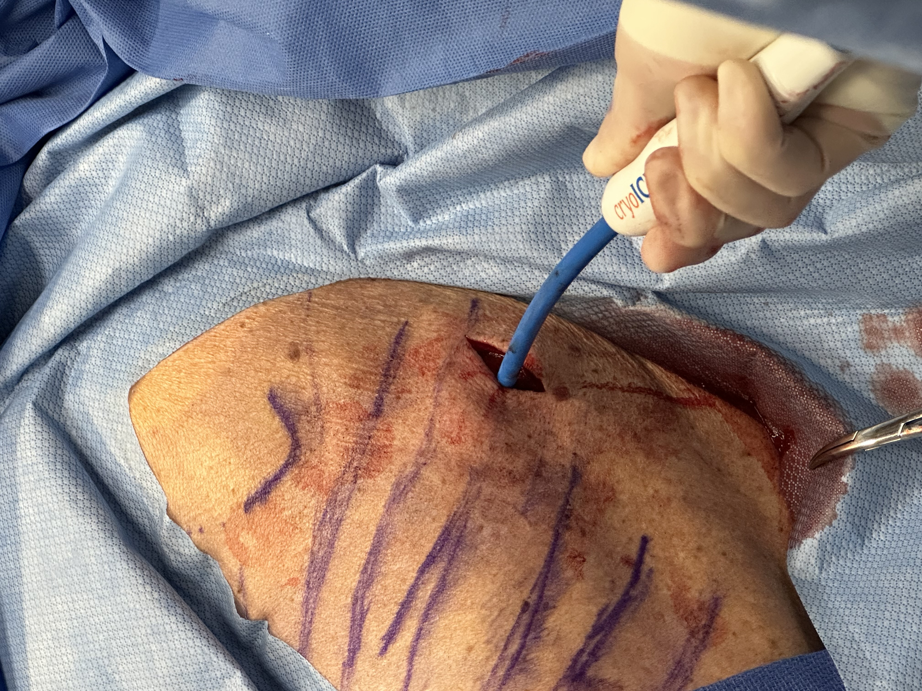
Bedside Intercostal Nerve Cryoablation Performed Under Conscious Sedation For Rib Fracture Pain
Enea Himi DO, Nathaniel Dilts MD, Christopher Watson MD, Philip Prest DO, Paul McQuillen
Department of Surgery, Prisma Health – University of South Carolina School of Medicine
Introduction
Patients with rib fractures are susceptible to developing pneumonia, atelectasis, and respiratory failure stemming from poor thoracic mechanics, diminished ventilatory capacity, and inability to clear secretions.^{1,4,5}
Surgical stabilization of rib fractures (SSRF) emerged as novel modality two decades ago.^{2,5} SSRF helps to minimize narcotic consumption,^{2,4,5,8} decrease hospital and ICU length of stay,⁴ as well as decrease the pulmonary complications previously mentioned.^{1,2} Despite such benefits, many patients still experience prolonged pain and discomfort after the intervention.⁹
To provide prolonged analgesic effect post-operatively, intercostal nerve cryoablation is routinely performed in conjunction with SSRF.^{1,4} A directly applied cryoprobe, using very low temperatures (-60 C), is used to destroy the nerve axon and myelin sheath of a selected peripheral nerve.^{1,3,4,5} This produces sustained ‘cryoanalgesia’ for up to 6 months in select cases.^{4,5}
Drawbacks to this synergistic model of rib fracture management include the need for an operating suite, general anesthesia, endotracheal intubation, and appropriately trained surgical staff. To circumvent these challenges, we have created a paradigm for performing intercostal nerve cryoablation at the bedside using conscious sedation. The following report is the first published case of bedside intercostal nerve cryoablation performed under conscious sedation for sustained rib fracture pain.
Case (continued)
To reach the intercostal bundle below the 5th rib, a separate 3 cm skin incision was made superiorly to the first incision at the medial border of the scapula. Nerve block and cryoablation of the intercostal bundle below the 5th rib was achieved in the same fashion as previously described. The surgical incisions were then irrigated and closed using 2-0 Vicryl suture and 4-0 Monocryl suture. Post-procedure chest x-ray was negative for a pneumothorax.
Conclusion
Our case report is the first published account of bedside intercostal nerve cryoablation performed under conscious sedation in a patient with multiple rib fractures. Up to this point, all reported accounts of surgical stabilization of rib fractures and intercostal nerve cryoablation have been performed in the operating room.⁴ The herein proposed model helps circumvent the need for a dedicated OR, allowing patients access to durable analgesia in their own rooms, at any time. Additionally, the use of conscious sedation and local anesthetic help to mitigate the risks of general anesthesia in a subset of trauma patients with prohibitive co-morbidities.⁶
Nelson et al. were the first to publicize the benefits of intercostal nerve cryoablation (IC) as a form of sustained pain-relief in post-thoracotomy patients in 1974. The sustained analgesic effects lasted from six to eight months, with normal return of sensation in 12 months.^{2,5} Prior to this, cryo-ablative therapy was routinely used for peripheral neuropathies and facial neuralgia.⁸ Many years later, Keller et al. compared the use of intercostal nerve cryoablation vs. thoracic epidural catheters for post-operative analgesia following pectus excavatum repair in children. They found that children treated with IC had decreased narcotic use post-operatively as well as a shortened hospital length of stay as compared to thoracic epidural catheters.^{3,8} Currently, IC is routinely performed alongside surgical stabilization of rib fractures at most high-volume trauma centers.^{1,4} Benefits of this adjunctive approach include decreased chest wall pain and narcotic use. ^{2,3,4,5,8}
Bedside intercostal nerve cryoablation under conscious sedation is a safe and accessible alternative to general anesthesia in the operative suite for rib fracture pain. The sustained analgesic effects of intercostal cryoablation ensure a faster transition out of the ICU while mitigating narcotic use.
Case
The patient is a 62-year-old male with a medical history of chronic obstructive pulmonary disease (COPD) and tobacco use, who presented to our hospital after a ground level mechanical fall. He sustained fractured ribs six thru eight on the left.
The patient was subsequently admitted to the trauma surgical floor and started on heated high flow nasal oxygen (HHFNC) as well as a multi-modal pain regimen as per our institutional rib fracture guidelines.
Despite these interventions, the patient’s pain level remained unchanged and surgical stabilization of his rib fractures with intercostal nerve cryoablation was offered as a treatment modality. The patient refused rib fixation under general anesthesia. As an alternative, bedside intercostal nerve cryoablation under conscious sedation was discussed with and accepted by the patient.
The patient was transferred to the surgical trauma intensive care unit (STICU) and point-of-care ultrasound was used to mark the fractured ribs. The patient was positioned in the right lateral decubitus position and conscious sedation was achieved using 120 mg of intravenous ketamine as well as 100 mcg of fentanyl. A separate surgical attending was responsible for the conscious sedation aspect of the procedure including monitoring of vitals.
20 ml of 1% lidocaine was used for local anesthesia at the planned surgical incision sites. A 4 cm longitudinal incision was made at the inferomedial border of the scapula. Blunt dissection was then used to reach the chest wall where the 7th rib was identified. 5 ml of a dexamethasone (8mg) /bupivacaine(30 ml) mixture was used to perform an intercostal block below the 7th rib. A Vanderbilt clamp was used to bluntly dissect the intercostal space. The cryo probe was then inserted in the intercostal space below rib 7, ensuring adequate distance from the sympathetic chain, and cooled to -120 °C. This was held in place for two minutes. From the same incision, the intercostal nerve bundles of ribs 6 and 8 were similarly addressed.
References
Choi J, Min JG, Jopling JK, Meshkin S, Bessoff KE, Forrester JD. Intercostal nerve cryoablation during surgical stabilization of rib fractures. J Trauma Acute Care Surg. 2021
Nelson KM, Vincent RG, Bourke RS, et al. Intraoperative intercostal nerve freezing to prevent postthoracotomy pain. Ann Thorac Surg. 1974;18(3):280-285.
Eldredge RS, McMahon L. Intercostal nerve cryoablation therapy for the repair of pectus excavatum: a systematic review. Front Surg. 2023;10:1235120. Published 2023 Aug 24.
Fokin AA, Hus N, Wycech J, Rodriguez E, Puente I. Surgical Stabilization of Rib Fractures: Indications, Techniques, and Pitfalls. JBJS Essent Surg Tech. 2020;10(2):e0032. Published 2020 May 7.
Clemence J Jr, Malik A, Farhat L, et al. Cryoablation of Intercostal Nerves Decreased Narcotic Usage After Thoracic or Thoracoabdominal Aortic Aneurysm Repair. Semin Thorac Cardiovasc Surg. 2020;32(3):404-412.
Bobbie JS. Preoperative evaluation for anesthesia for noncardiac surgery. In: UpToDate, Connor RF (Ed), Wolters Kluwer. Accessed March 11 2024.
Vana PG, Neubauer DC, Luchette FA. Contemporary management of flail chest. Am Surg. 2014;80(6):527-535.
Keller BA, Kabagambe SK, Becker JC, Chen YJ, Goodman LF, Clark-Wronski JM, et al. Intercostal nerve cryoablation versus thoracic epidural catheters for postoperative analgesia following pectus excavatum repair: preliminary outcomes in twenty-six cryoablation patients. J Pediatr Surg. (2016)
Meyer DE, Harvin JA, Vincent L, et al. Randomized Controlled Trial of Surgical Rib Fixation to Nonoperative Management in Severe Chest Wall Injury. Ann Surg. 2023;278(3):357-365.
Prologo JD, Johnson C, Hawkins CM, et al. Natural History of Mixed and Motor Nerve Cryoablation in Humans-A Cohort Analysis. J Vasc Interv Radiol. 2020;31(6):912-916.e1.
Results
The patient was able to safely weaned from HHFNC to supplemental oxygen with regular nasal cannula on post-op day 1. He was subsequently downgraded to the surgical floor with continued physical therapy. He was discharged home on post-op day 9 with a total length of stay of 10 days.

